Slide 1
SchwarzShuttle Data Platform

Slide 2
Agenda
1
System Architecture
2
Requirements
3
Automated Deployment
4
Continuous Integration and Deployment
5
Development and Deployment Workflow
6
Data Security Measures
7
Future Vision for SchwarzShuttle Data Platform

Slide 3
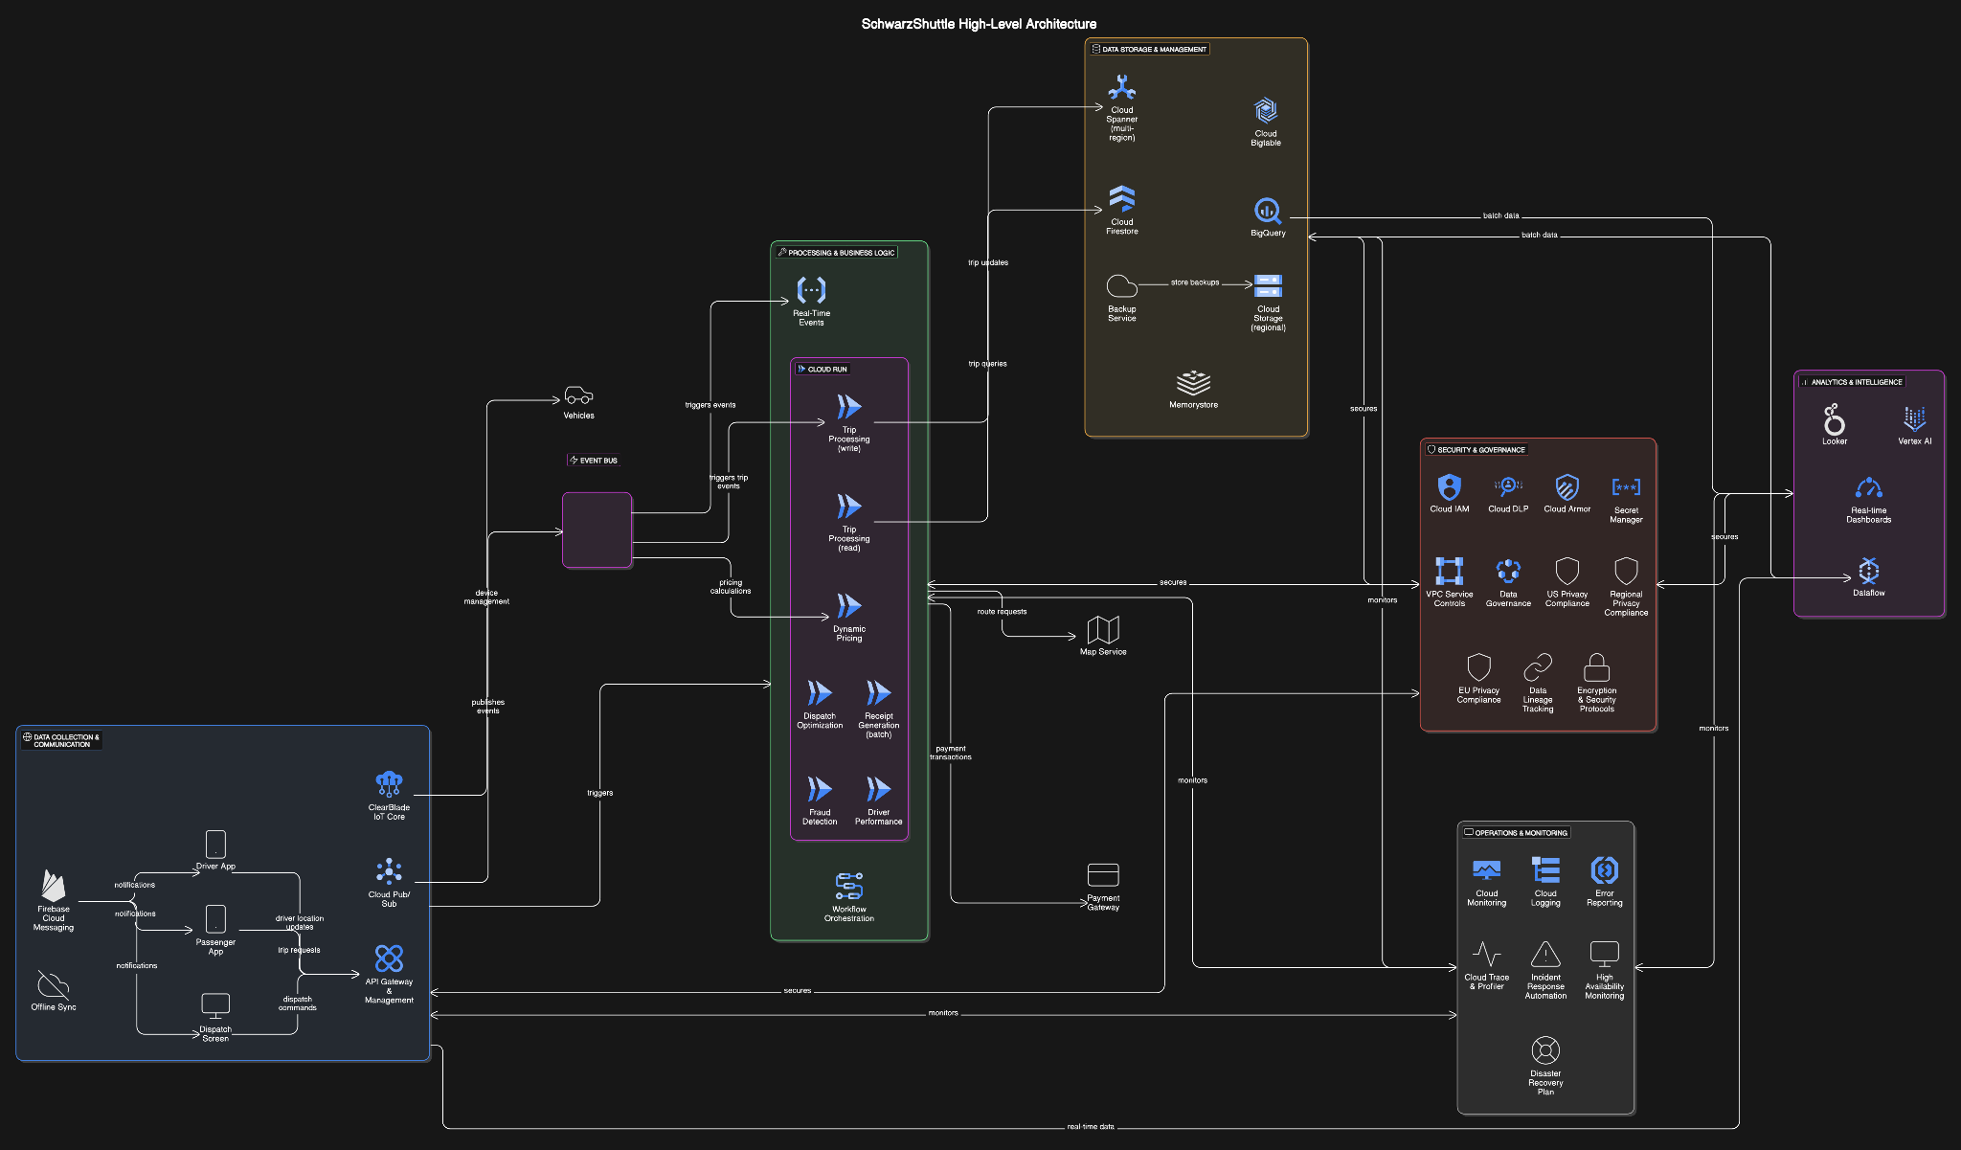
SchwarzShuttle Data Platform Architecture
Highlights:
Real-time data ingestion from IoT devices for operational efficiency.
Machine learning with Vertex AI for fleet optimization and fraud prevention.
Scalable, serverless design with Cloud Functions and App Engine.
Secure storage with Customer-Managed Encryption Keys (CMEK).

Slide 4
Functional and Non-Functional Requirements
Functional Requirements:
Trip Revenue Management: Track and manage trip revenues.
Fleet Optimization: Optimize vehicle allocation based on demand.
Fraud Prevention System: Detect fraudulent activities in real-time.
Executive Dashboards & Analytics: Offer insights for decision-making.
Operational Efficiency Analysis: Improve operations using data.
Non-Functional Requirements:
Performance: Low-latency processing during peak loads.
Security: Encryption and access control for data protection.
Scalability: Auto-scaling to handle growth.
Reliability: High availability with fault tolerance.
Usability: Intuitive dashboards for executives.

Slide 5
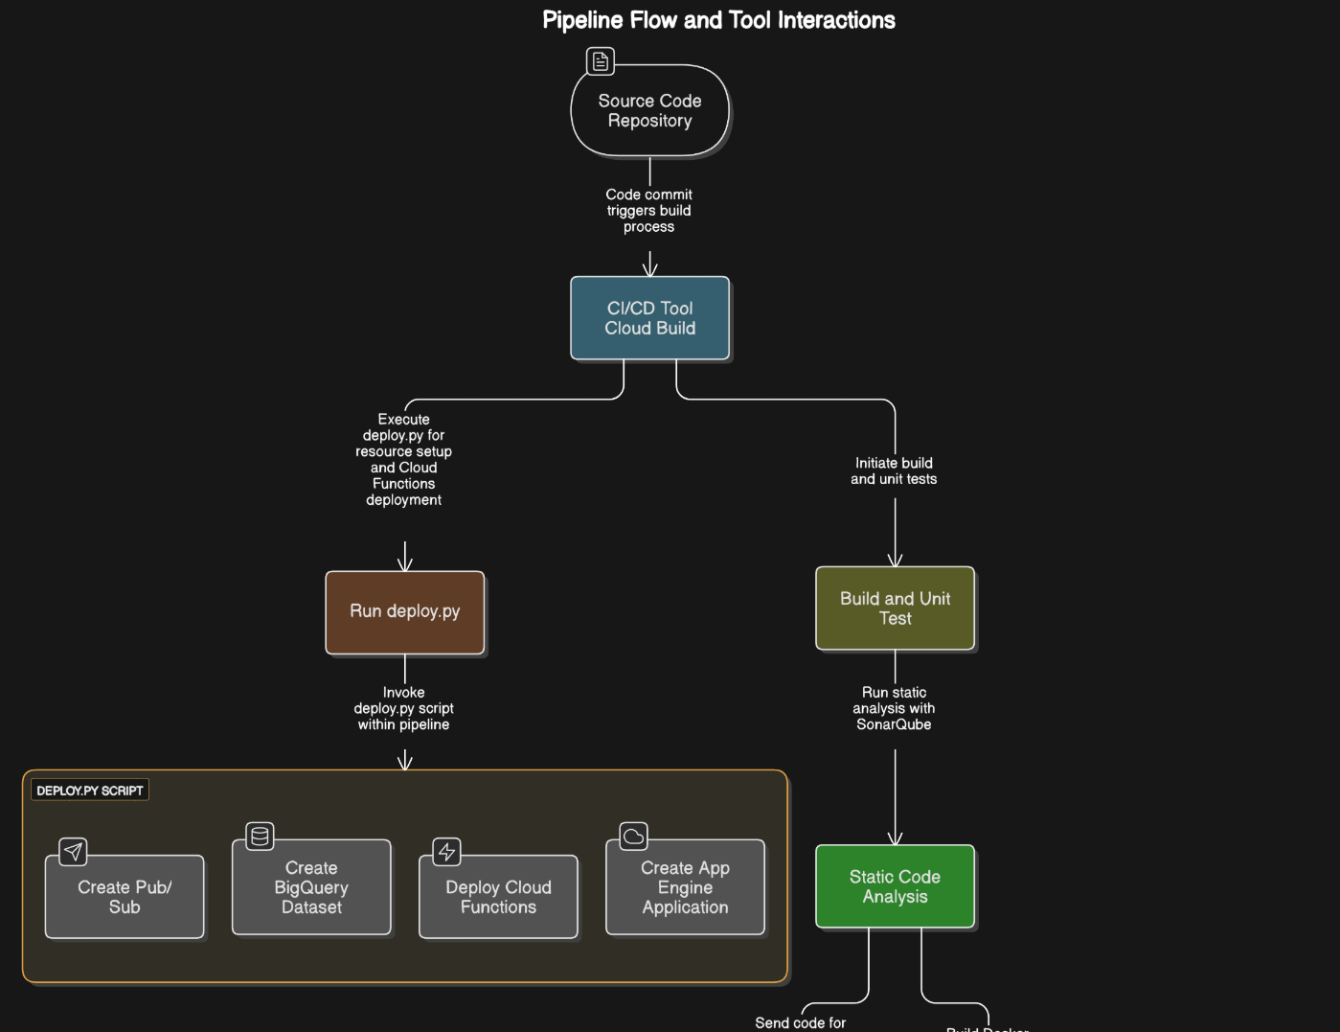
Automated Deployment with deploy.py
Automates provisioning of Pub/Sub, BigQuery, and Cloud Functions.
Sets up security with CMEK, IAM, and log sinks.
Ensures consistent deployments, reducing manual errors.
Integrates with CI/CD for continuous updates.

Slide 6
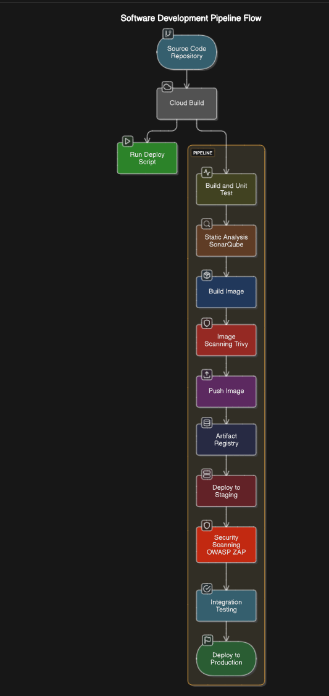
DevOps/DevSecOps Pipeline
Automated build, test, and deployment with Cloud Build.
Security scans: SonarQube (static), Trivy (image), OWASP ZAP (dynamic).
Deploy.py sets up resources and Cloud Functions early in the pipeline.

Slide 7
Development and Deployment Workflow
Steps:
Commit code to repository (e.g., GitHub).
Cloud Build triggers and runs deploy.py for resource setup and Cloud Functions.
Build and run unit tests on App Engine code.
Security analysis with SonarQube, Trivy, and OWASP ZAP.
Deploy to staging for integration tests.
Deploy to production if tests pass.

Slide 8
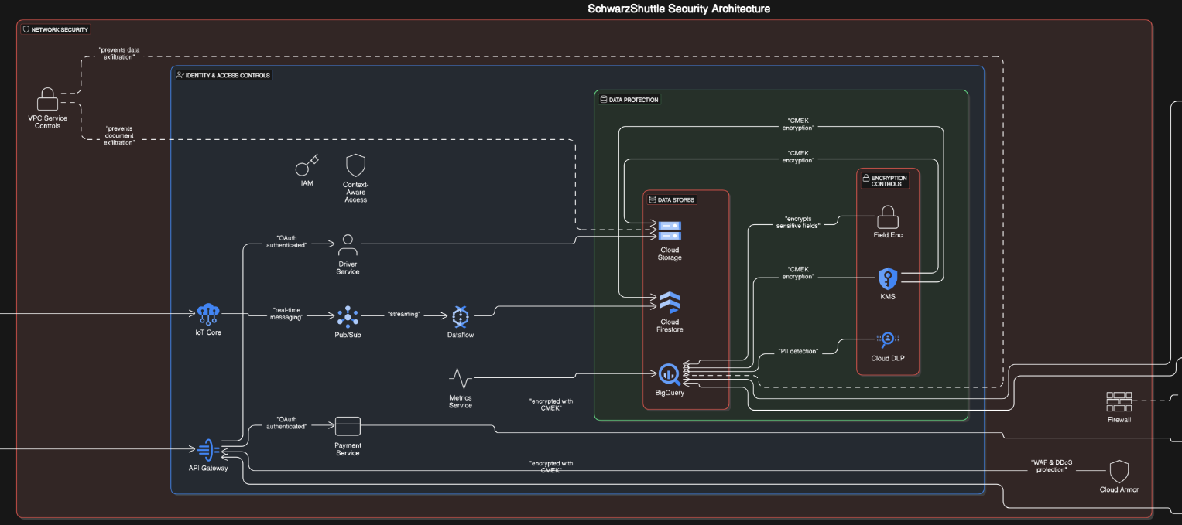
Preventing Data Exfiltration and Infiltration
CMEK: Encrypts BigQuery data at rest (via deploy.py).
IAM: Controls access with least privilege (via deploy.py).
Log Sinks to BigQuery: Monitors activity for incidents (via deploy.py).
Security Scanning Tools: SonarQube, Trivy, OWASP ZAP in pipeline.
Layered security ensures data protection, supporting customer trust and compliance.

Slide 9

Key Focus Areas (Next 2-3 Years)
AI-Driven Insights: Predictive maintenance, dynamic pricing.
Global Scalability: Multi-region support and compliance.
Customer-Centric Innovations: Personalized services via analytics.
Sustainability: Route optimization for lower emissions.
Cybersecurity: Proactive threat defense, potential blockchain integration.
Photo by Luke Chesser on Unsplash

Slide 10
Q&A
Open Floor: Inviting questions from the audience.

